Slide 1


CHASSIS AND ERGONOMICS
DESIGN
REPORT
PRV 20

Slide 2
INDEX
5
TORSIONAL STIFFNESS
1
OVERALL DESIGN CONCEPT
Calculation Method ................................ 9
Department ODC …........................................ 1
1
6
FINITE ELEMENT ANALYSIS
FMEA
FMEA …......................................................... 2
Boundary Conditions ….......................... 10
Results …................................................. 11
Engine Mount Analysis …....................... 12
2
DESIGN CONSTRAINTS
Suspension Geometry …................................. 3
Powertrain Packaging …................................. 3
Driver Ergonomics …...................................... 4
FSAE Rules …................................................. 5
7
MODAL ANALYSIS
Introduction …........................................ 13
Tabular Results …................................... 13
Conclusions …........................................ 14
Comparison ….........................................15
3
MATERIAL SELECTION
Material Properties Graph ….......................... 6
8
ENGINE VIBRATION REDUCTION
4
FORCES ON THE CHASSIS
Engine Vibration Reduction .................. 16
Longitudinal Torsion …................................. 7
Vertical Bending …........................................ 7
Lateral Bending …......................................... 8
Horizontal Lozenging …................................ 8
9
TRIANGULATION
Triangulation ......................................... 17

Slide 3
INDEX
10
13
SUSPENSION MOUNTING POINTS
STEERING WHEEL
Mounting Method …............................. 18
Steering wheel Design ....................... 28
Manufacturing .................................. 30
Steering Wheel Display …................. 31
Steering Wheel Comparison............... 32
10
CHASSIS MANUFACTURING
Manufacturing Process .......................... 19
14
PADDLE SHIFTERS
10
ERGONOMICS OVERVIEW
Paddle shifter Design ....................... 33
Manufacturing ................................. 34
Paddle shifter Comparison................ 35
Manufacturing Process .......................... 20
11
15
ERGONOMIC JIG
DASHBOARD
Ergonomic Parameters …..................... 21
Manufacturing ….................................. 22
Driver Data ........................................... 23
Dashboard Design ........................... 36
Calculation of Height ...................... 37
12
16
SEAT DESIGN
PEDAL ASSEMBLY
Design Parameters ............................... 24
Design ….............................................. 25
Manufacturing .................................... 26
Seat Insert …........................................ 27
Pedal Assembly Design .................... 38
17
FUTURE GOALS
Future Goals ..................................... 40

Slide 4

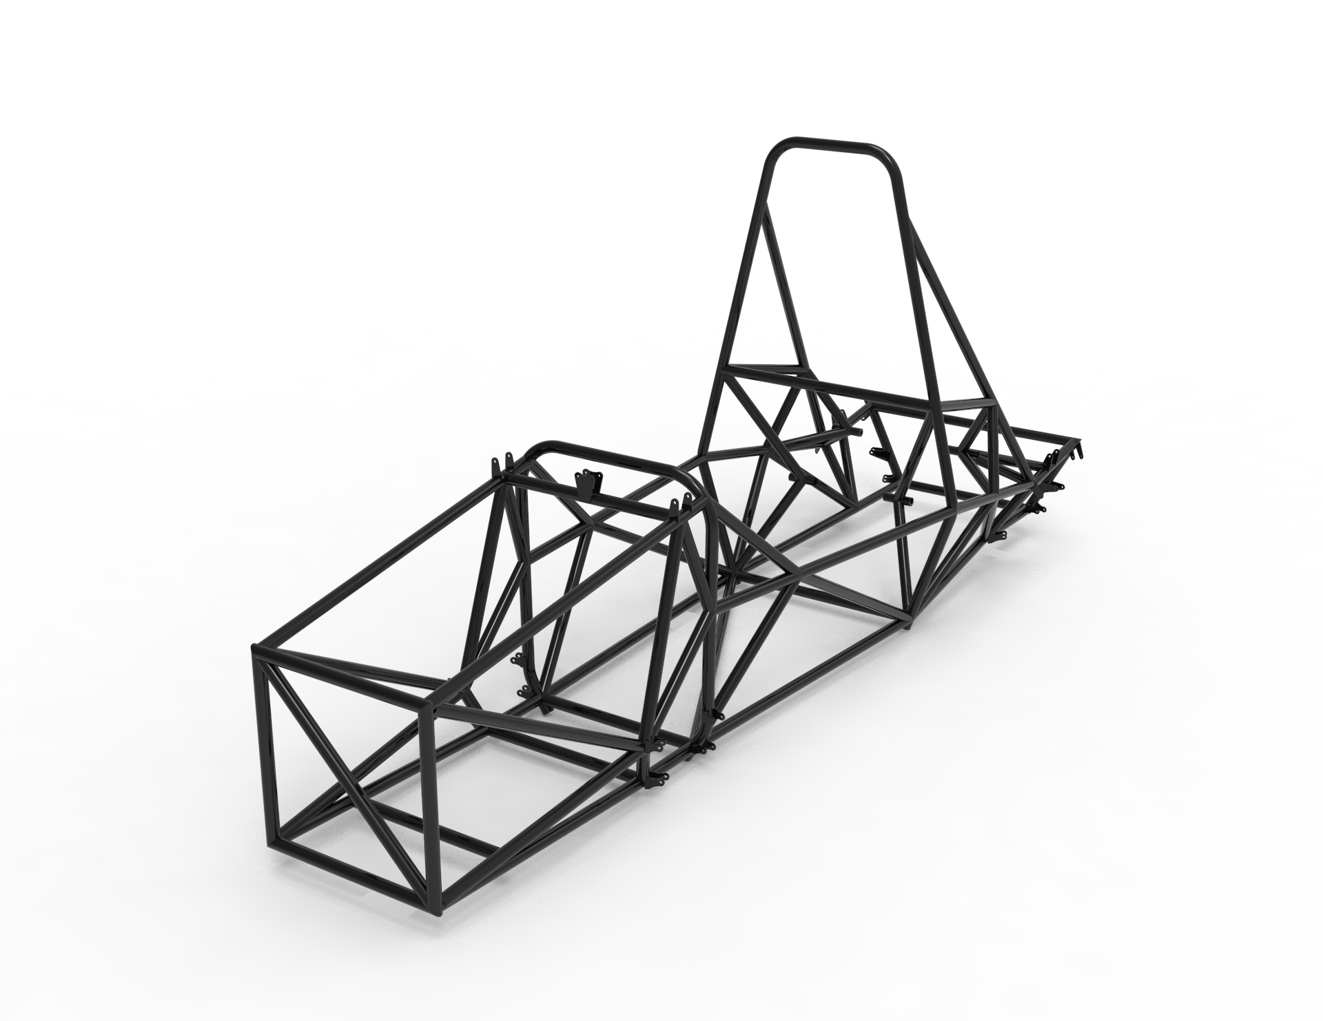
DEPARTMENT ODC
To design a car with a frame which is rigid in bending as well as lightweight and which provides optimum comfort and assist the driver to achieve its peak performance
Goals:
Chassis
Minimum Tubes
Maximum Triangulation
Optimum Nodes
Ergonomics
Comfortable Cockpit Design
Optimum Field of Vision
Adjustable Cockpit
1

Slide 5
FMEA
Item/Function | Function | Potential Failure Modes | Potential Effects of Failure | SEV | Potential Causes of Failure | OCC | Current Design Controls (prevention) | Current Design Controls (selection) | DET | RPN | Recommendation Action
Chassis | To mount the components on vehicle and support | Linkages are not welded properly | Leads to excess vibrations which may lead to breakage of members | 4 | When proper welding type is not studied or welding not done properly | 3 | Various welding techniques were studied and TIG welding was chosen | Reliability test | 2 | 24 | Using proper welding method for joining tube , analysis strength of welding tensile testing machine , or having non-destructive testing of weld cracks
 | The loads in different conditions | Improper choice of material type | Leads to undue flexing and deflection | 2 | Improper material analysis in FEA software | 2 | Material chosen after performing different physical test and comparing with baseline steel | Physical Property testing Physical Property testing | 3 | 12 | Analysing all the material taken into design consideration with proper boundary conditions in simulation
 |  | Structure not properly triangulated | Improper load transfer may lead to the high stress concentration in some regions | 3 | Chassis designing not done properly | 2 | Best possible triangulated sections were considered | After performing multiple Iterations | 3 | 18 | Taking into consideration all possible arrangement of members for obtaining optimum load paths
Seat and seat inserts | To support the driver and provide safety | Frame failure of seat | Driver safety compromised | 5 | Excessive loads | 2 | Using Design guides as reference | Durability and Reliability Test | 4 | 40 | Selection of proper material with required critical bearing stress
Paddle Shifters | For upshifting and downshifting of gears | Improper selection of magnets | Improper retracting mechanism | 3 | Magnetic range not analysed properly | 2 | Various magnet samples were tested, and their strength was analysed. Two neodymium magnets gives the best result | Durability Test | 3 | 12 | Proper analysing the magnetic range. Finding the range up to which magnetic effect can be sensed.

Slide 6
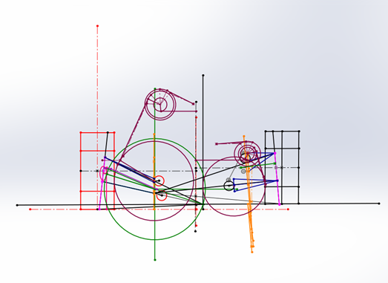
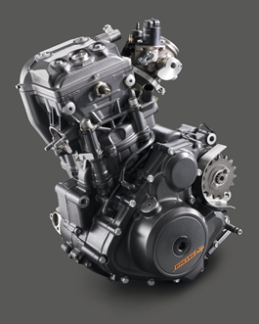
DESIGN PROCESS
DESIGN CONSTRAINTS:
1
SUSPENSION GEOMETRY
Suspension pickup points
Bell crank mounting points
Damper mounting points
ARB mounting points
2
POWERTRAIN AND DRIVETRAIN PACKAGING
Engine accommodation and mounting
Cooling and Lubrication Routing and mounting
Spool and its mounting
Ease of assembly and disassembly
Decides the rear length of the chassis
3

Slide 7
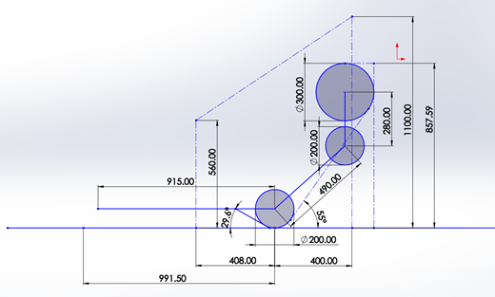
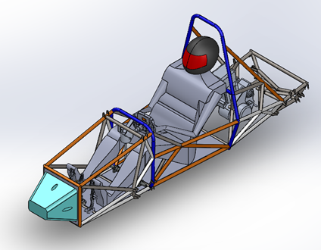
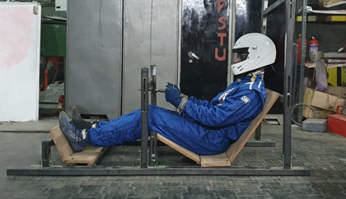
DESIGN CONSTRAINTS:
3
DRIVER ERGONOMIC
Cockpit Parameters based on drivability of each driver
Dimensions of the chassis to accommodate all drivers
Ease of egress
Optimum visibility in the front of the vehicle
Driver jig
Plot of Driver Anthropometric Data
Mankind Assembly based on anthropometric data
4

Slide 8
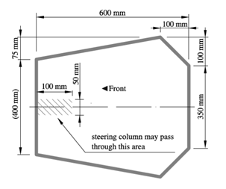
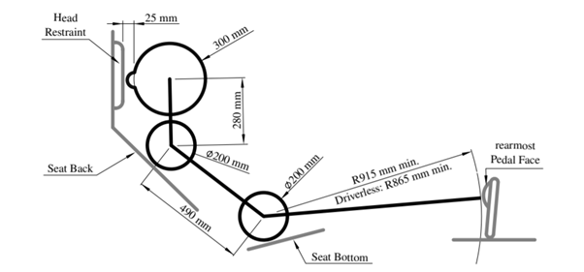
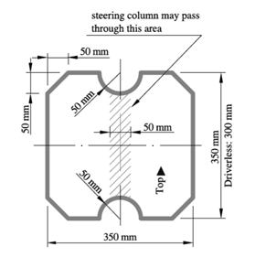
DESIGN CONSTRAINTS:
4
FSAE Rules
Cockpit Opening Template
Internal Cross-section Template
95th Percentile Template
Decides the front length of the chassis
5

Slide 9
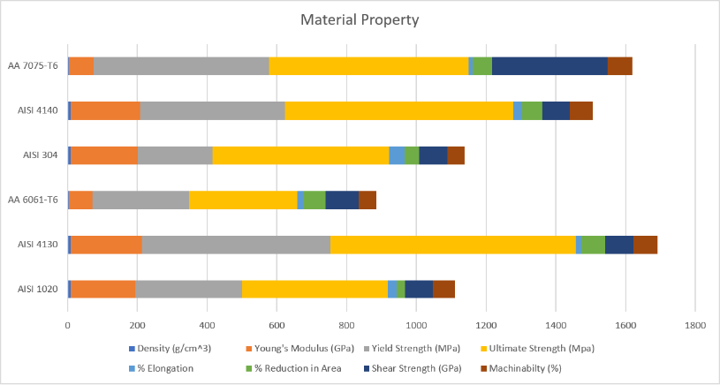
MATERIAL SELECTION
AISI 4130 (chromoly) is selected as a material for chassis production taking into consideration manufacturing parameters – machinability, weld ability.
Flexural rigidity for different materials are specified for a tube of 25.4 mm outer diameter and 1.2 mm thickness:
Flexural Rigidity:
AISI 1020
1339 Nm²
AISI 4130
1372.475 Nm²
AA 6061-T6
461.286 Nm²
AISI 304
AISI 4140
AA 7075-T6
1292.135 Nm²
1339.01 Nm²
480.035 Nm²
6

Slide 10
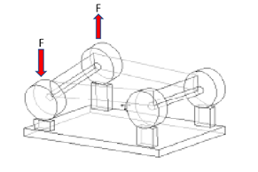
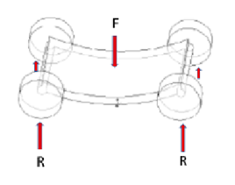
VARIOUS FORCES ACTING ON RACE CAR CHASSIS
1
LONGITUDINAL TORSION
During Cornering
Major contribution to Force
2
VERTICAL BENDING
Due to weight of driver, engine and other components mounted to the frame
7

Slide 11
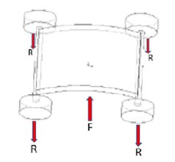
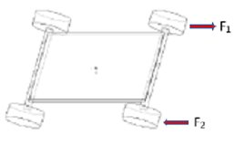
VARIOUS FORCES ACTING ON RACE CAR CHASSIS
3
LATERAL BENDING
Due to road camber, side wind loads, and centrifugal forces caused by cornering
4
HORIZONTAL LOZENGING
Due to uneven forces on adjacent tires
8

Slide 12
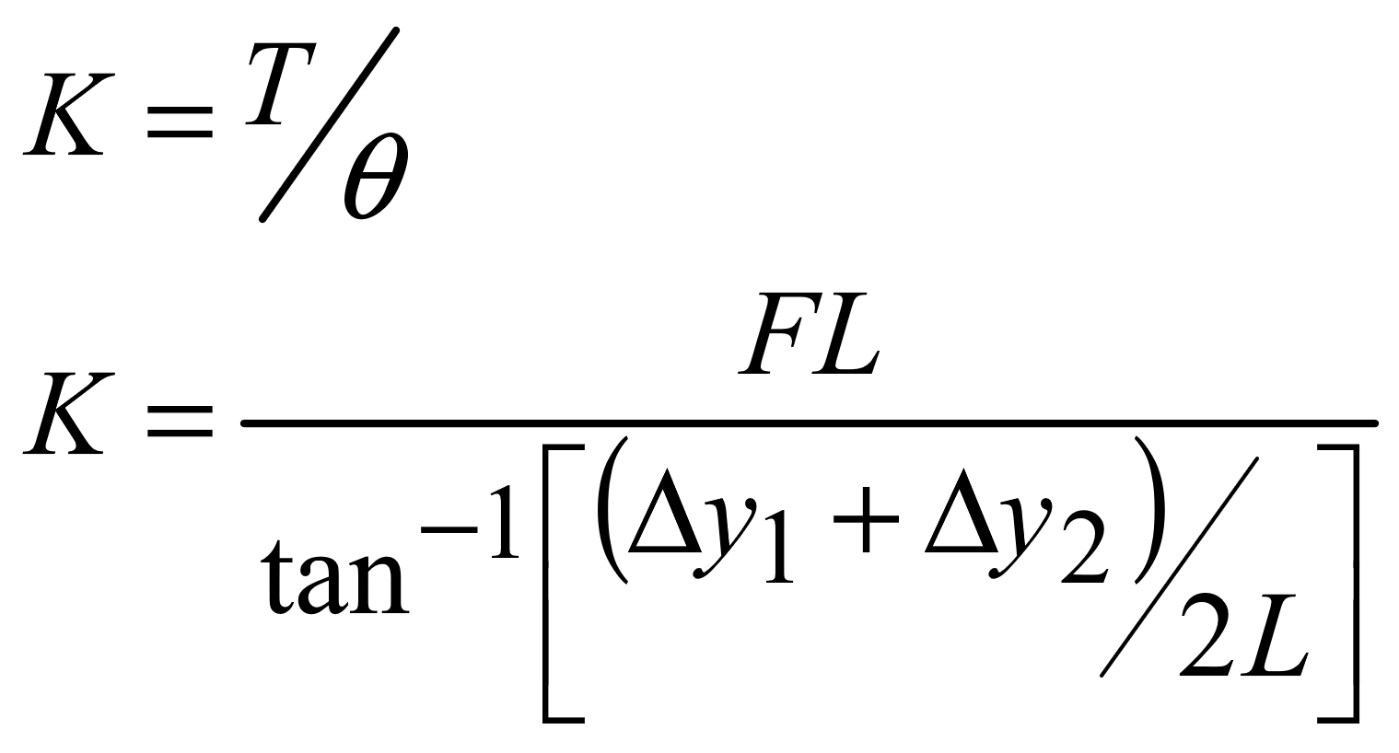
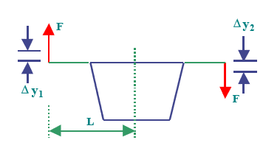
TORSIONAL STIFFNESS CALCULATION
Finite element model of Chassis was constructed in ANSYS Mechanical APDL 18.1 and 20.1 student version.
9

Slide 13
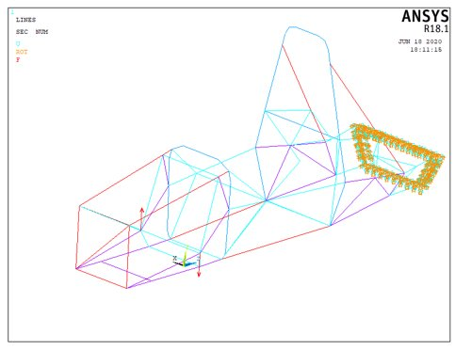
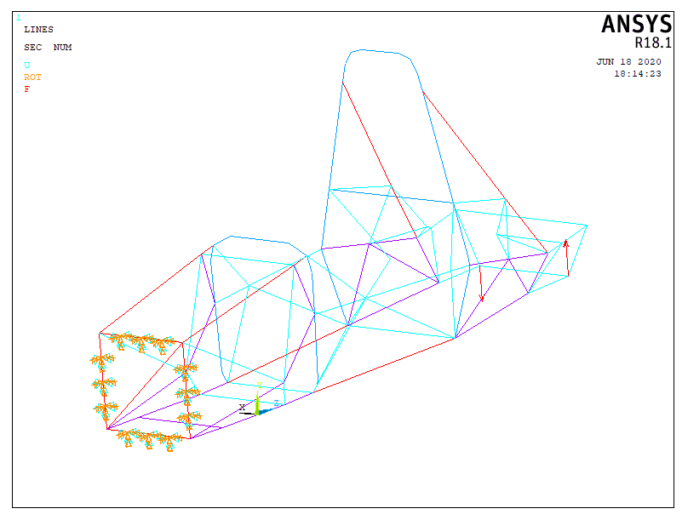
BOUNDARY CONDITIONS
CONDITION 1:
Rear portion of the chassis is fixed; couple is applied on the front suspension pick up points
CONDITION 2:
Front portion of the chassis is fixed; couple is applied on the rear suspension pick up points
10

Slide 14
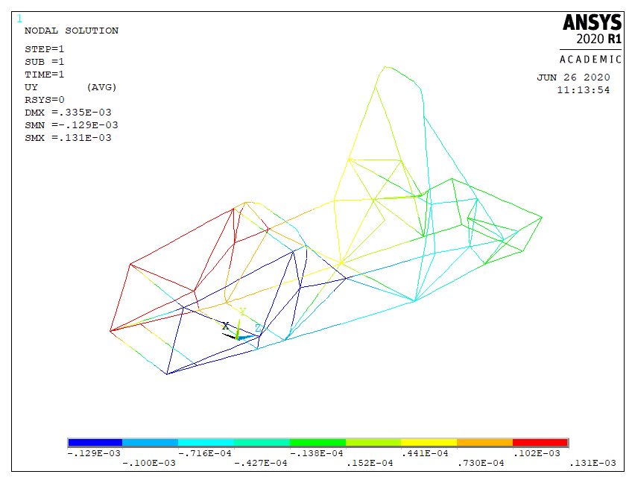
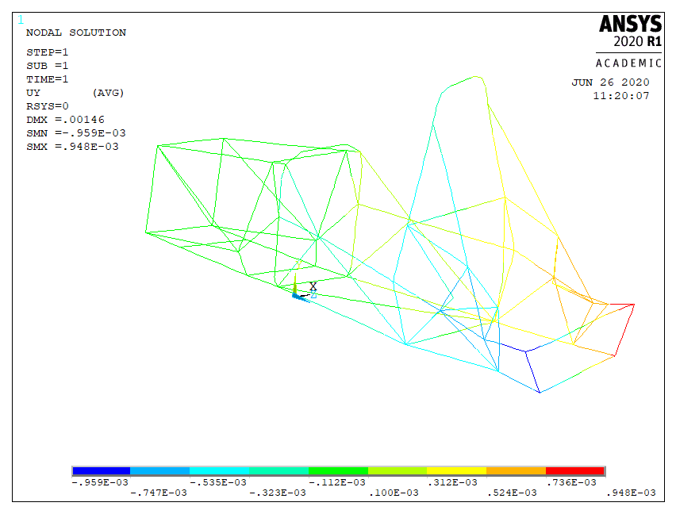
RESULTS
Displacement in Y direction
CONDITION 1
CONDITION 2
TORSIONAL STIFFNESS: 2274 Nm/deg
11

Slide 15
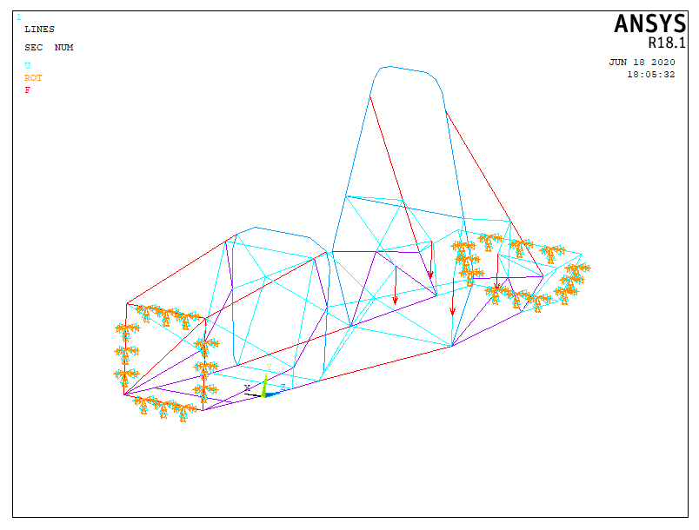
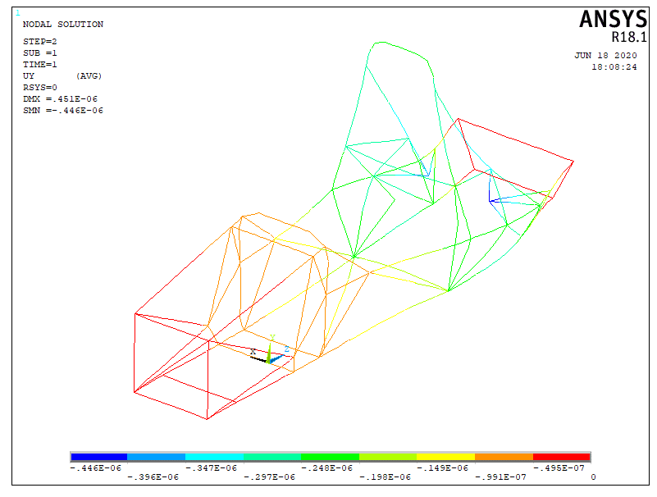
ENGINE MOUNTS ANALYSIS
Displacement in Y direction
BOUNDARY CONDITION:
The front and rear bulkhead were fixed and a load of 400N was applied on the four engine mounts.
12

Slide 16
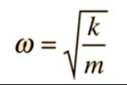
When perturbed, any solid body will vibrate at its natural frequency
Analysis of the frame's response under vibration
Stiffness to Weight Ratio determined
MODAL ANALYSIS
Natural Frequencies:
Harmonic | Frequency
1 | 0
2 | 0
3 | 0
4 | 1.3911E-04
5 | 3.4997E-04
Harmonic | Frequency
6 | 6.0346E-04
7 | 37.271
8 | 57.157
9 | 69.100
10 | 82.752
13

Slide 17
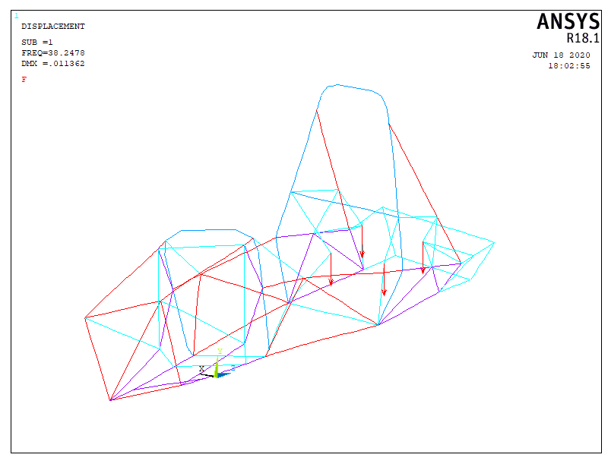
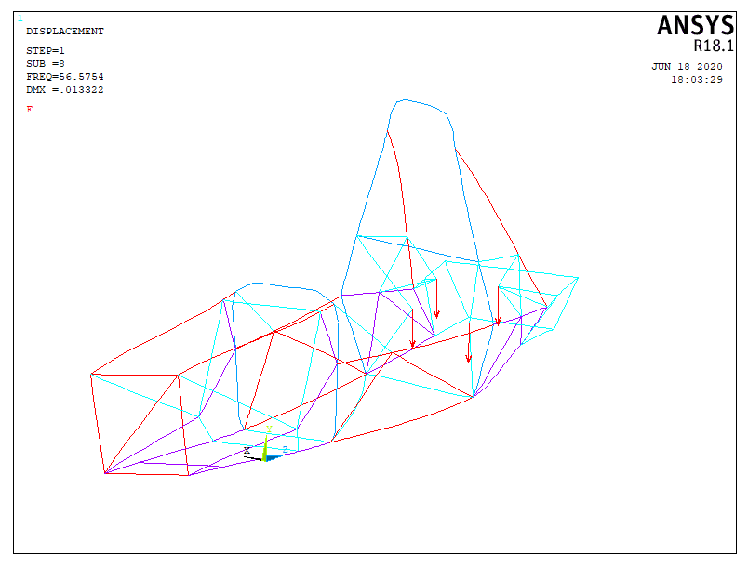
MODAL ANALYSIS
7th mode correspond to twisting motion along longitudinal axis of chassis
8th mode correspond to the longitudinal flexure
Important for longitudinal and flexural rigidity
7th Order Mode Shape
8th Order Mode Shape
14

Slide 18
MODAL ANALYSIS
Additional analysis was done by removing the extra supporting tubes at the rear engine mounts.
Harmonic values with engine mounts supporting tubes:
Harmonic values without engine mounts supporting tubes:
Harmonic | Frequency
7 | 37.271
8 | 57.157
9 | 69.100
10 | 82.752
Harmonic | Frequency
7 | 37.214
8 | 55.906
9 | 68.870
10 | 82.649
Larger value at each harmonic
Better Triangulation
Better design
15

Slide 19
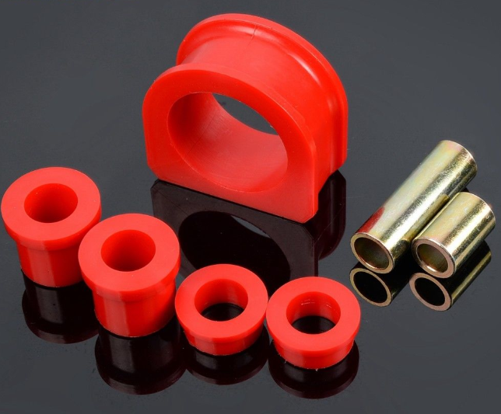
ENGINE VIBRATION REDUCTION
Primary source of vibrations in the chassis is from the engine
Large vibratory forces are transferred from the engine into the chassis
In the two previous chassis designs, the frame suffered weld joint failures near the engine.
PU Bushing
16

Slide 20
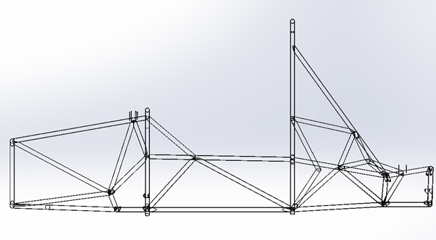
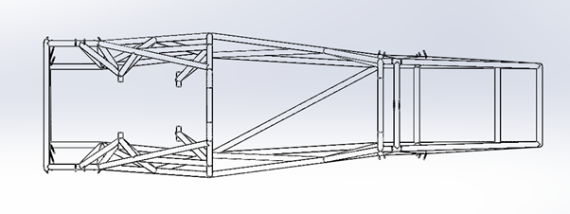
TRIANGULATION
Proper triangulation to transfer the loads to different members to minimise stress concentration
17

Slide 21
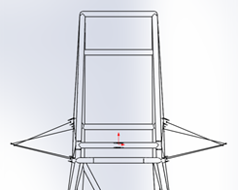
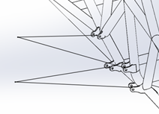
Shear Force on brackets and bending of brackets prevented
Brackets carrying suspension loads designed on the axes of linkages
SUSPENSION MOUNTING POINTS
Only Tensile and Compressive forces act on the brackets
Tabs are welded at the junction of three or more tubes. These will prevent bending loads and provide load transfer to chassis
18

Slide 22
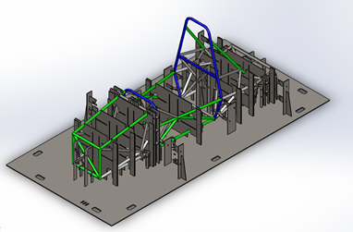
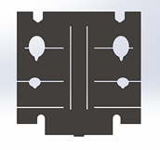
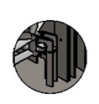
CHASSIS MANUFACTURING
Fixture supports 8 tubes thus reducing the number of fixtures to be welded
Followed DFMA principles
Each chassis member is supported at atleasttwo points to maintain its orientation
Each chassis member is supported at atleasttwo points to maintain its orientation
Separate fixtures for suspension tabs to obtain precise angle and orientation
19

Slide 23
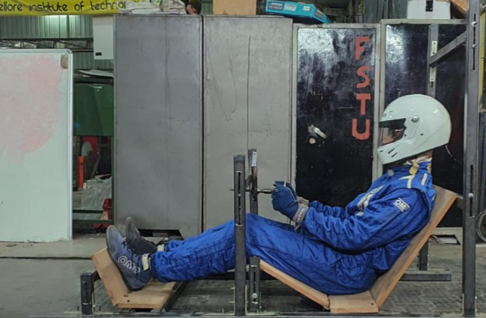
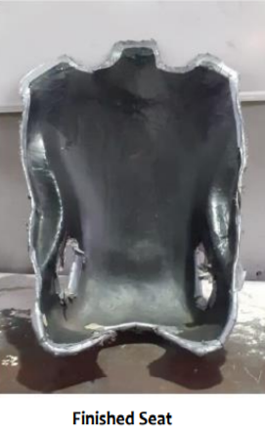
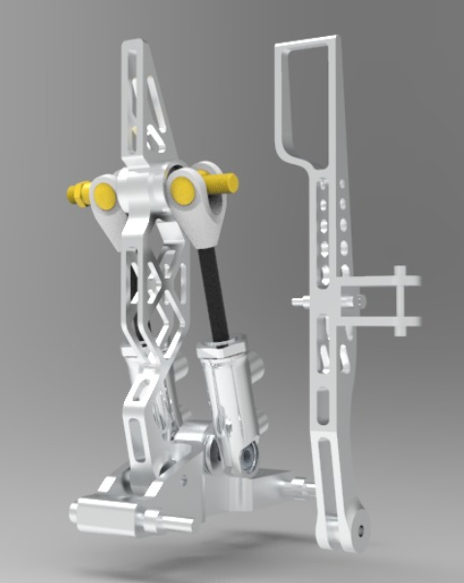
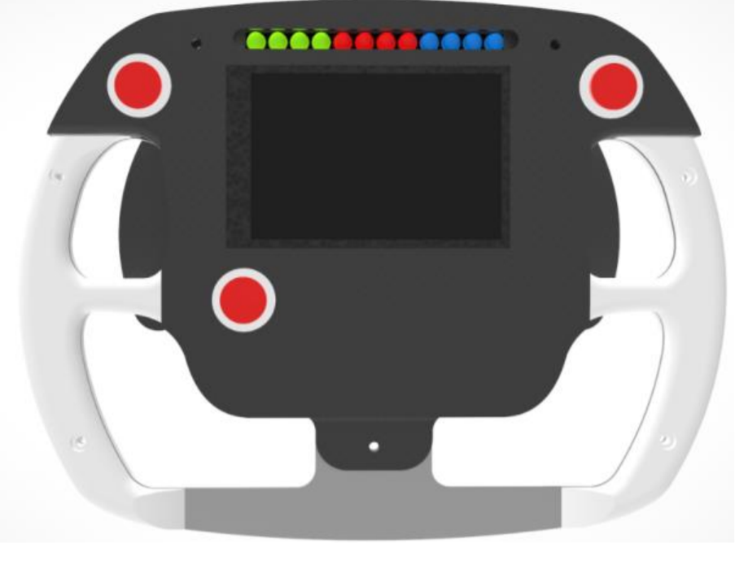
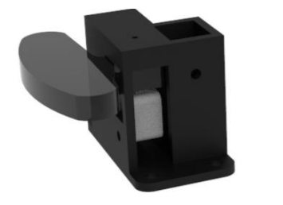
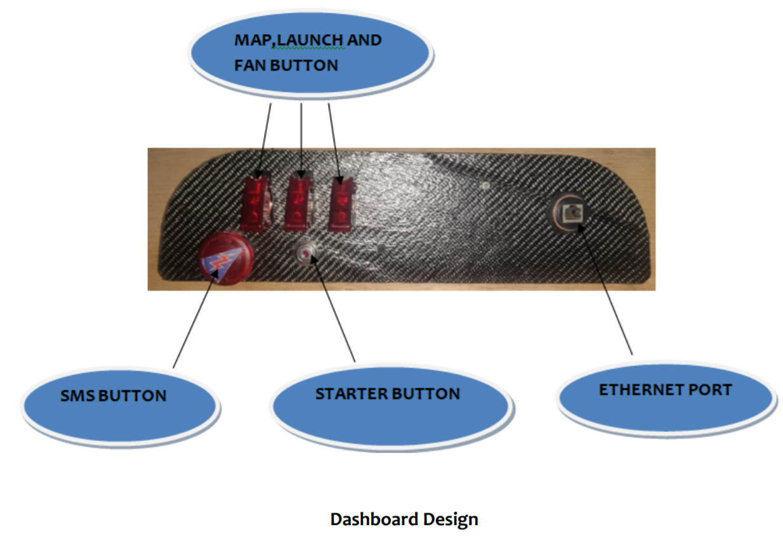
ERGONOMICS OVERVIEW
Ergonomic Jig
Seat
Pedal Assembly
Dashboard
Paddle Shifters
20
Steering Wheel

Slide 24
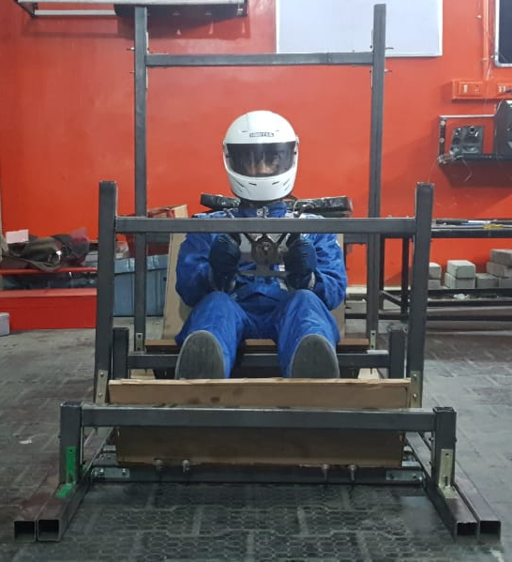
ERGONOMIC PARAMETERS
Length and Width of Cockpit
Roll Hoops Location
Dashboard Height and Angle
Steering Wheel Location
Pedal Height and Position
Thigh Angle
Seat Back Angle
21

Slide 25
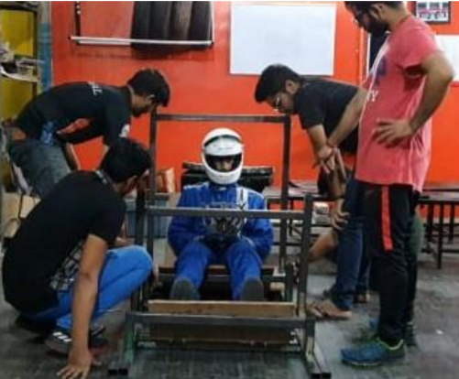
ERGONOMIC JIG
Adjustable driver jig to incorporate data for all drivers for cockpit design
Stable support using mild steel tubes ensured correct data collection
Stable wooden support ensured correct seat, back, thigh angles and pedal position
22

Slide 26
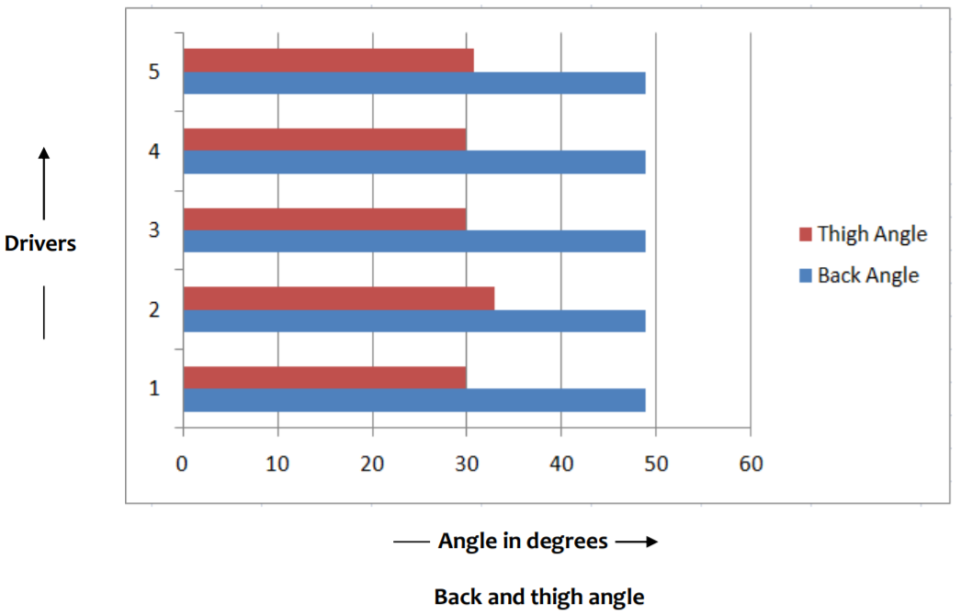
COCKPIT DESIGN
Adjustable driver's jig
Optimum driver data
Better cockpit design
Back and Thigh Angles
Optimum driver data for chassis design
23

Slide 27
SEAT DESIGN PARAMETERS
To accommodate all the drivers at their preferred driving position Driver Jig data and 95th Percentile male data were referred to decide the following seat parameters.
1
4
SEAT CUSHION ANGLE AND HEIGHT
SEAT BEACK ANGLE
2
5
LUMBAR AND FORE AFT SUPPORT
ARMREST HEIGHT, LENGTH AND LATERAL LOCATION
3
6
LOCATION OF DRIVER HARNESS BELTS
SEAT HEIGHT
24

Slide 28
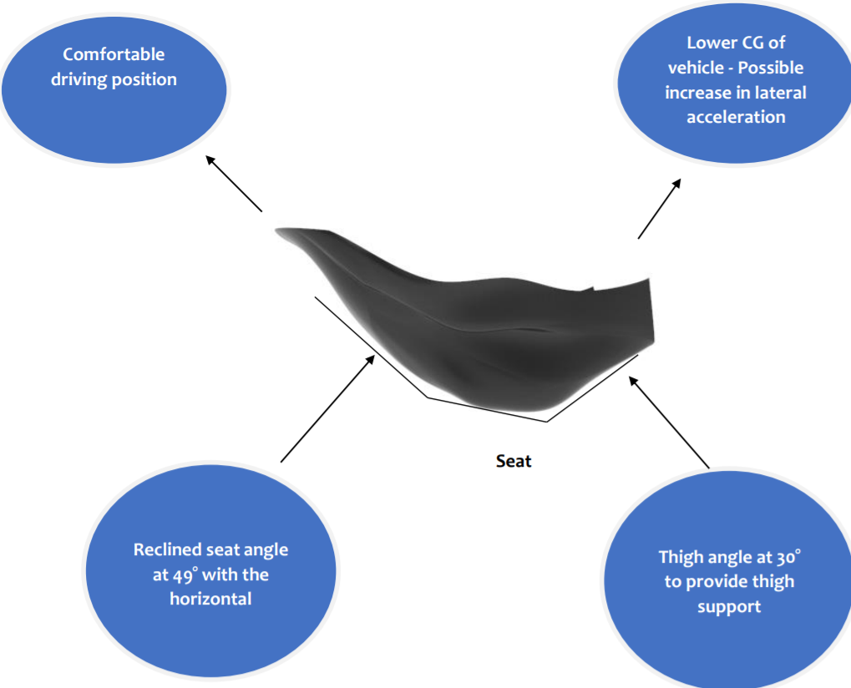
SEAT DESIGN
Comfortable driving position
Lower CG of vehicle – Possible increase in lateral acceleration
Reclined seat angle at 49⁰ with the horizontal
Thigh angle is at 30⁰ to provide thigh support
25

Slide 29
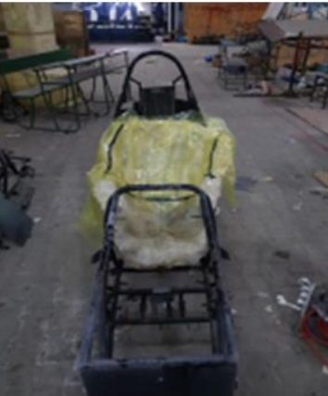
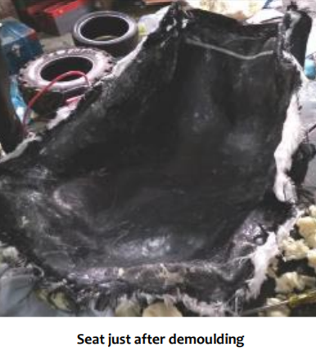
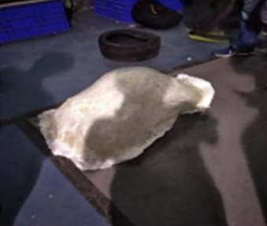
SEAT MANUFACTURING
Seat just after demoulding
Finished Seat
26

Slide 30
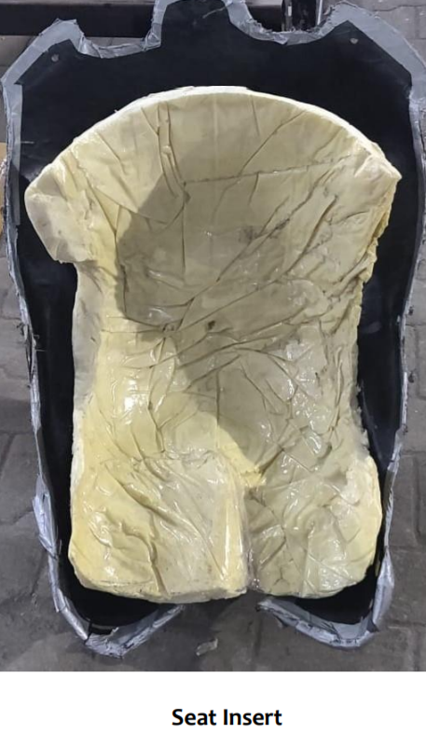
SEAT INSERT
1
PROVIDE RAISED HEIGHT
2
ACCOMMODATE DRIVERS OF DIFFERENT STATURES
3
PROVIDE CUSTOMIZED LUMBAR SUPPORT
27

Slide 31
STEERING WHEEL DESIGN
Turn wheel without elbows hitting legs
Upper arm and forearm at 90⁰
Operate Paddle shifters without steering wheel contact
Goals
28

Slide 32
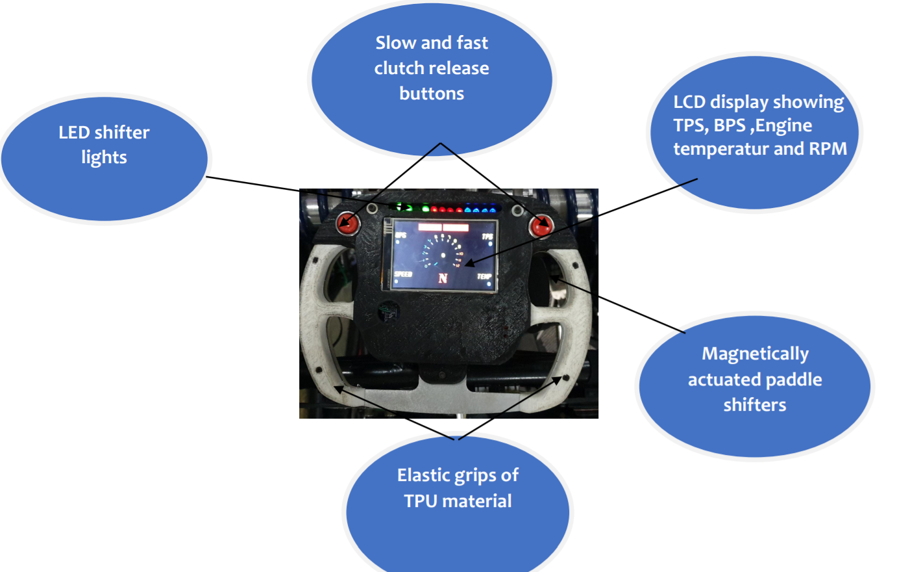
Slow and fast clutch release buttons
Magnetically actuated paddle shifters
RPM indicator
lights
Acquiring information available
Processing the sensed information to understand the situation
Selecting what to do
Executing the response
Elastic grips of TPU material
LCD display showing TPS, BPS, Engine temperature and RPM
29

Slide 33
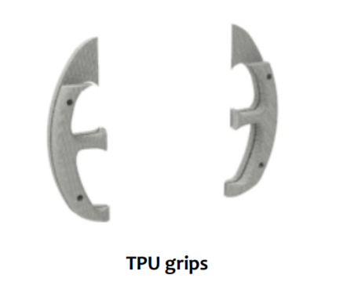
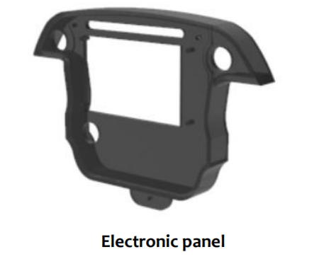


Steering Wheel
TPU grips
FDM 3D printed
TPU
Electronic Panel
FDM 3D printed
Steering Wheel Baseplate
Lasercut
ABS
Aluminium
STEERING WHEEL MANUFACTURING
30

Slide 34


STEERING WHEEL DISPLAY
Cone receptors specialized in detecting red, green and blue
Red colour persists for maximum time
Blue colour has largest peripheral region
Steering wheels mounted on car
31

Slide 35


STEERING WHEEL COMPARISON
Last Season | Current Season | Goals Achieved
Absence of 3D LCD display for driver assistance | LCD display for better drivability | Enhanced Drivability
Packaging of electrical components was the major issue | Incorporating 3D printed enclosure to accommodate electrical components | Improved Packaging and Ease of Assembly
Absence of compromised driver's comfort | 3D printed grips made of TPU material for driver compfort | Lightweight
Last Season
Current Season
32

Slide 36

PADDLE SHIFTERS
Paddle shifters were designed to reduce driver effort and improve shifting time.
Shifters were designed with driver inputs on steering wheel and the position of shifters were made to improve ease of shifting even while cornering
Customised paddle shifter design
Magnetic actuated paddle shifters mounted on Steering wheel
33

Slide 37




Shifting Switch
Paddle
Paddle Housing
Neodymium Magnets
The paddle shifters consists of three parts that are 3D printed. Two neodymium magnets were incorporated.
Paddle was made to pivot about a point and two magnets were pasted on upper and lower parts of paddle and housing respectively
34

Slide 38


PADDLE SHIFTER COMPARISON
Last Season | Current Season | Goals Achieved
Retracting mechanism using springs | Retracting mechanism using magnets | Improved Reliability
Torsional spring was under tension all the times therefore had limited life and had to be replaced regularly | Usage of magnets resulted in increased life cycle of the part | Optimised Efficiency
Fixing the spring inside to pivot the paddle was a big issue and retracting was not efficient | Easy fixing of the system since magnets are used and resulted in better retracting | Ease of Assembly
Last Season
Current Season
35

Slide 39
DASHBOARD DESIGN
MAP, LAUNCH AND FAN BUTTON
SMS BUTTON
STARTER BUTTON
ETHERNET PORT
36

Slide 40

CALCULATION OF DASHBOARD HEIGHT
Located such that driver's visibility os 20 feet ahead
Height decided such that sufficient clearance from floor for egress
Dashboard Location
Dashboard Height
27.08 inches
37

Slide 41

PEDAL ASSEMBLY DESIGN
Appropriate height for comfort of drivers
Driver can reach and actuate the pedals
Goals
Pedals mounted on chassis
Adjustable pedal assembly to incorporate all drivers
Design and assembly was made robust for fast changing
All forces from pedals dissipating into chassis
38

Slide 42


PEDAL ASSEMBLY DESIGN
1
290mm HEIGHT OF PEDAL
2
ADJUSTABILITY OF 50mm, 25mm FORE AND 25mm AFT
3
PROVIDE RAISED HEIGHT
39

Slide 43



FUTURE GOALS
1
3
Mathematical model to incorporate chassis stiffness, Weld Strength, Suspension Stiffness
Hybrid Chassis
2
Real time data of forces from Strain Gauges
4
Reduced Steering Effort and Ankle Strain
40

